Slide 1

Monte Carlo Simulation of Light Propagation in Multi-layered Tissue Using High-Level Synthesis
Presented by: Jin Hee Kim Lawrence Park Sadegh Yazdanshenas
Notes:
Jin Hee

Slide 2
Outline
Introduction
Design Overview
Experimental Results
Demo
1 / 21
Notes:
Jin Hee

Slide 3
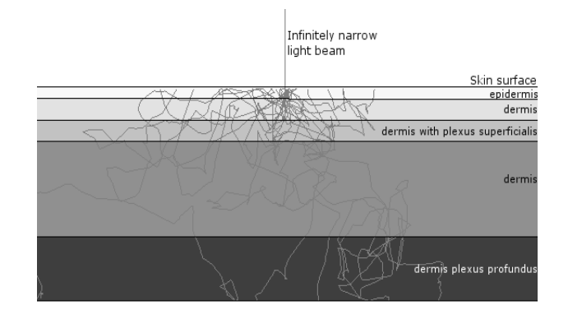
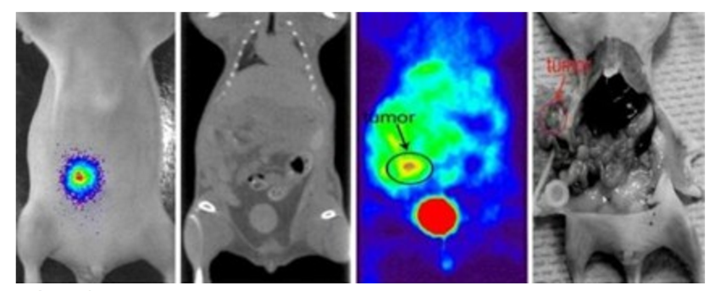


Introduction
Introduction | Design Overview | Experimental Results | Demo
Simulate the propagation of a photon beam through multi-layer tissue(s)
Promising applications in medical research
Bioluminescence Imaging (BLI)
Photodynamic Therapy (PDT)
2 / 21
Notes:
Jin Hee

Slide 4
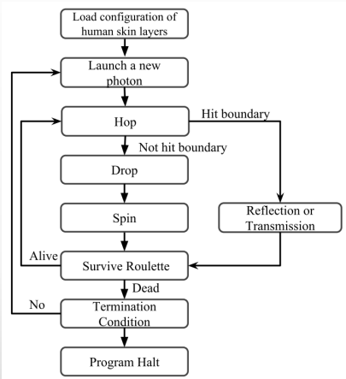
Sequential Algorithm
Introduction | Design Overview | Experimental Results | Demo
3 key steps for a photon packet
Hop step moves the packet to a next position based on a probability distribution
Drop step adjusts the packet’s weight to simulate absorption
Spin step simulates photon scattering (direction update)
A packet is terminated when exits
the tissue or by the “Survive Roulette”
3 / 21
Notes:
Anyone

Slide 5
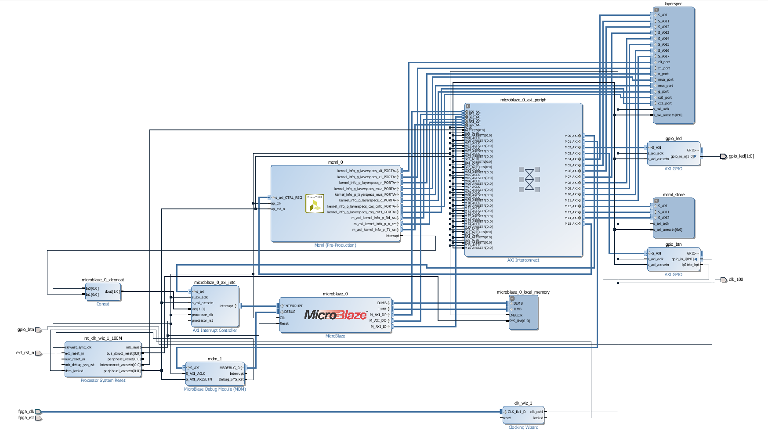
The Big Picture
Introduction | Design Overview | Experimental Results | Demo
4 / 21
Notes:
Lawrence

Slide 6
Changes in the Algorithm
Introduction | Design Overview | Experimental Results | Demo
All photons operate independently.
Great opportunity for parallelism.
Can memory handle this parallelism?
GPU implementations take this approach!
FPGA-specific approach:
Pipeline the data path.
Create multiple computation kernels.
Each photon depends on its previous iteration
How can we pipeline the design?!
5 / 21
Notes:
Sadegh

Slide 7
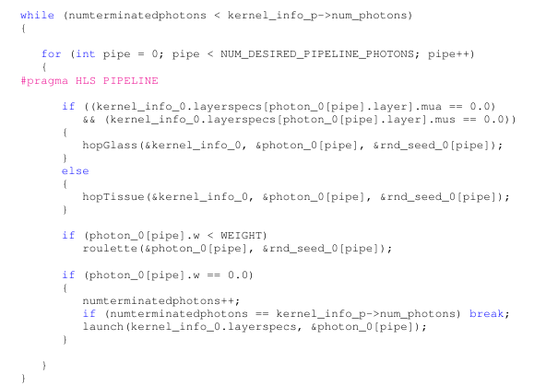
Changes in the Algorithm
Introduction | Design Overview | Experimental Results | Demo
6 / 21
Notes:
Sadegh

Slide 8
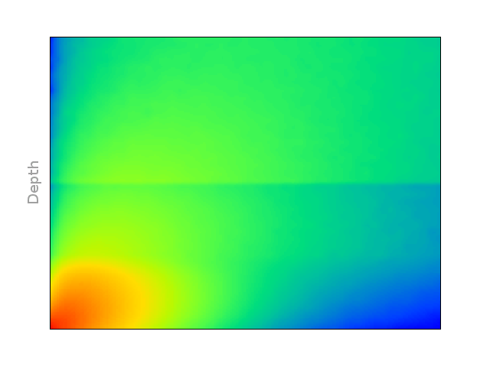
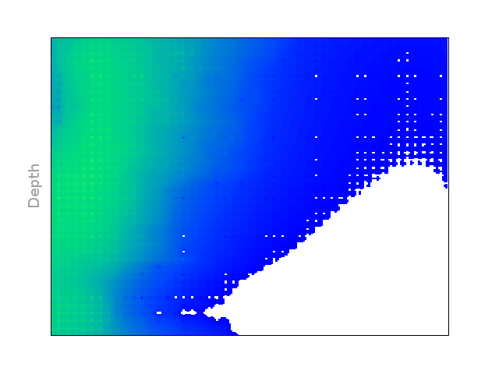
Some Interesting Issues: Random Number Generation
Introduction | Design Overview | Experimental Results | Demo
Has to be uniform!
Preferably low-cost and fast!
7 / 21
Notes:
Sadegh and Jin Hee

Slide 9
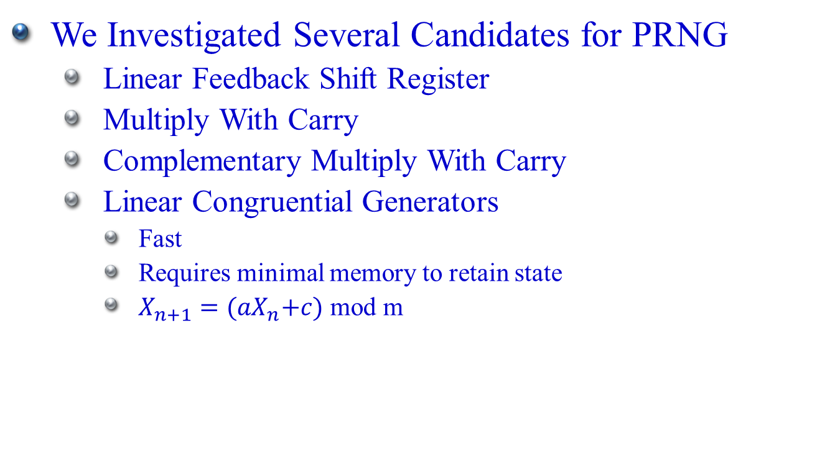
Some Interesting Issues: Random Number Generation
Introduction | Design Overview | Experimental Results | Demo
We Investigated Several Candidates for PRNG
Linear Feedback Shift Register
Multiply With Carry
Complementary Multiply With Carry
Linear Congruential Generators
Fast
Requires minimal memory to retain state
$X_{n+1}={(aX}_{n}+c)$ mod m
8 / 21
Notes:
Sadegh and Jin Hee

Slide 10
Pipelining Challenges
Introduction | Design Overview | Experimental Results | Demo
Problem: clock latency
Target period = 10ns but Estimated period = 40ns
Critical path: rand() function
Pipeline the rand function – without success:
Applied pipeline pragma directly to the function
Tried to inline function
No warnings to indicate the reason for lack of pipeline
9 / 21
Notes:
Jin Hee

Slide 11
Pipelining Challenges
Introduction | Design Overview | Experimental Results | Demo
Problem: clock latency
Rand() function produces the next random value depending on the current value
One variable to keep track of the current rand value
Rand value is needed by various parts of the algorithm
Treated rand() function as an atomic operation
Solution
Code was changed to assign a random number per photon
Since each photon only update its own, it can be pipelined
Had to inline some functions or the tool messed up
10 / 21
Notes:
Jin Hee

Slide 12
Memory Dependencies
Introduction | Design Overview | Experimental Results | Demo
Problem: Memory dependences
Target II = 1 but Estimated II = 5
Photon weight deposits in tissue must be recorded
Index to the tissue is random and no pattern exists
RAW dependence due to having one array
Need to read the current value, add the new deposit, and store
Takes 5 cycles (Read -> Add -> Write)
11 / 21
Notes:
Pipelining Jinhee

Slide 13
Memory Dependencies: Possible Solution
Introduction | Design Overview | Experimental Results | Demo
Problem: Memory dependences
Target II = 1 but Estimated II = 5
Possible Solution:
Can use multiple arrays to store then add at the end
Since updating tissue record takes 5 cycles, have 5 arrays
Each cycle, add to one of the 5 arrays
Need to add the 5 arrays at the end
However, no longer any dependencies
Could not find C code structure and pragmas to implement
12 / 21
Notes:
Pipelining Jinhee

Slide 14
Minor Optimizations
Introduction | Design Overview | Experimental Results | Demo
Some complex functions were required in our Implementation:
Arccosine
Cosine
Sine
HLS does not support Arccosine.
We filled a RAM block with output data and indexed it accordingly.
Float division
Store the inverse and multiply
13 / 21
Notes:
Pipelining Jinhee

Slide 15
Parallel Challenges
Introduction | Design Overview | Experimental Results | Demo
Problem: run mcml in parallel
Running the loop in parallel within the HLS is beneficial since we can keep all of the loops busy
At the system level, need to use global memory to keep track of terminated photons OR let some kernels idle
Could not find C code to parallelize
Create separate loops and unroll with a factor of 2
Create 2 sets of input and output to the function
Create same function with 2 different names
14 / 21
Notes:
Jin Hee

Slide 16
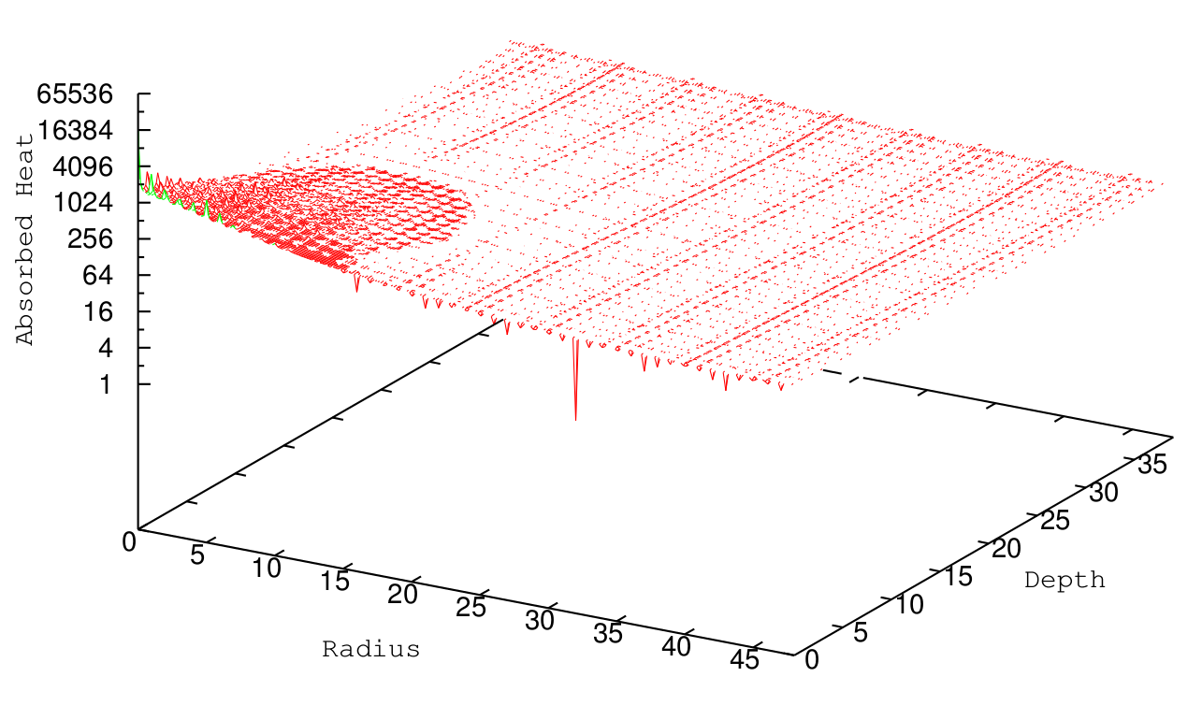
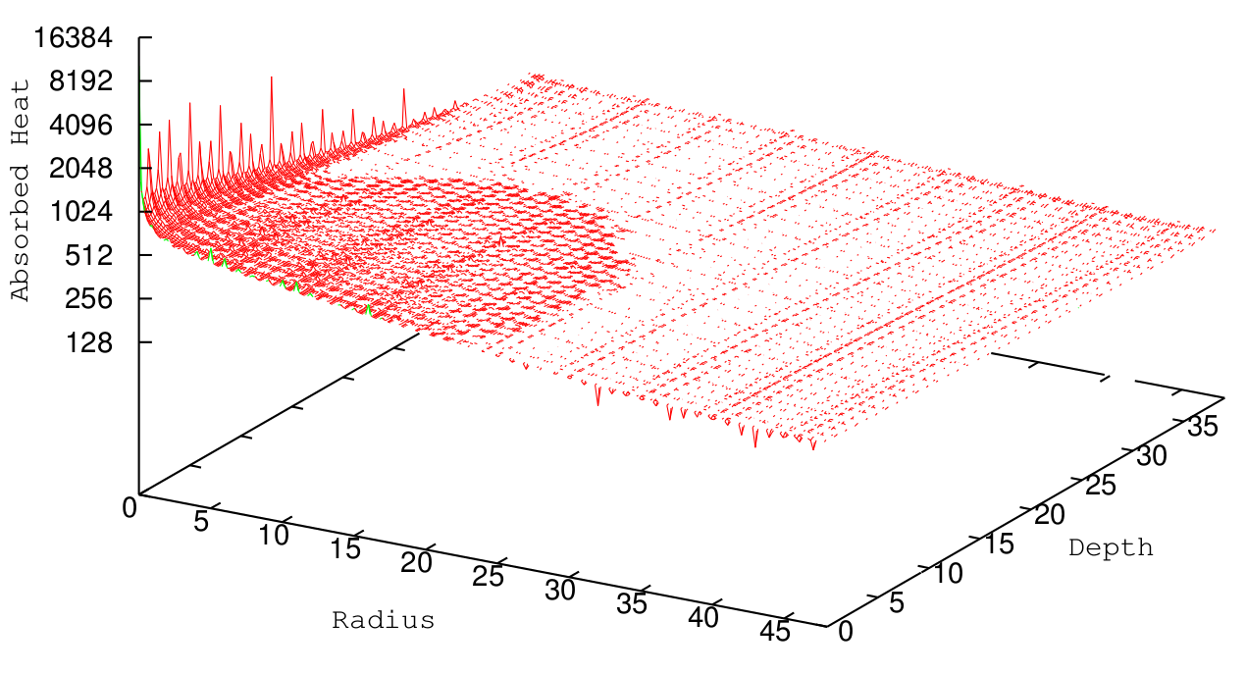
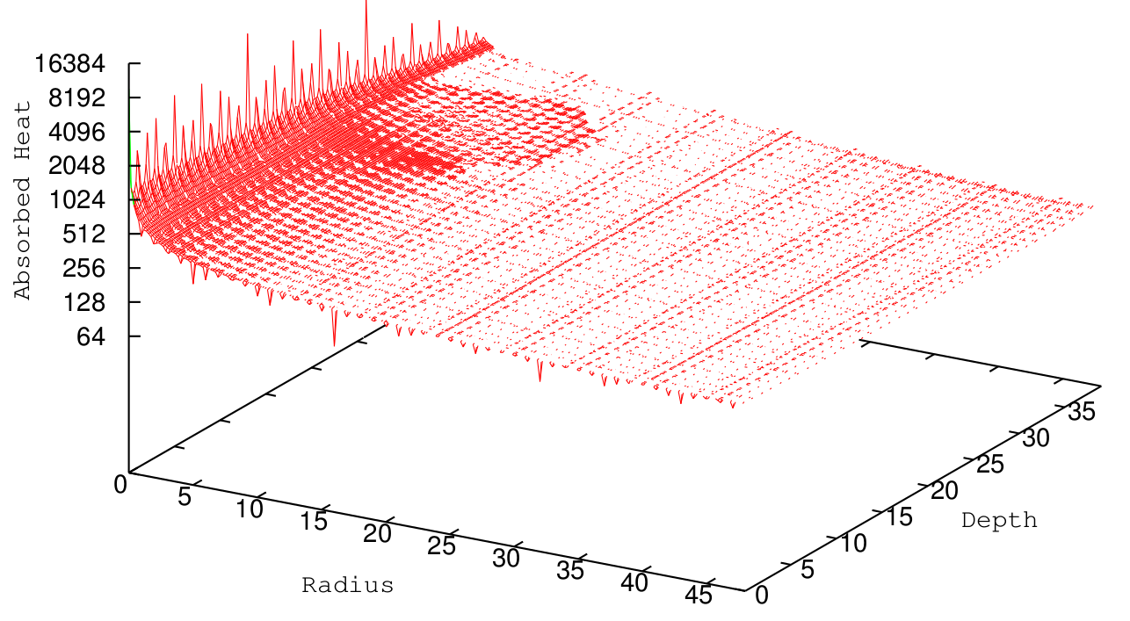
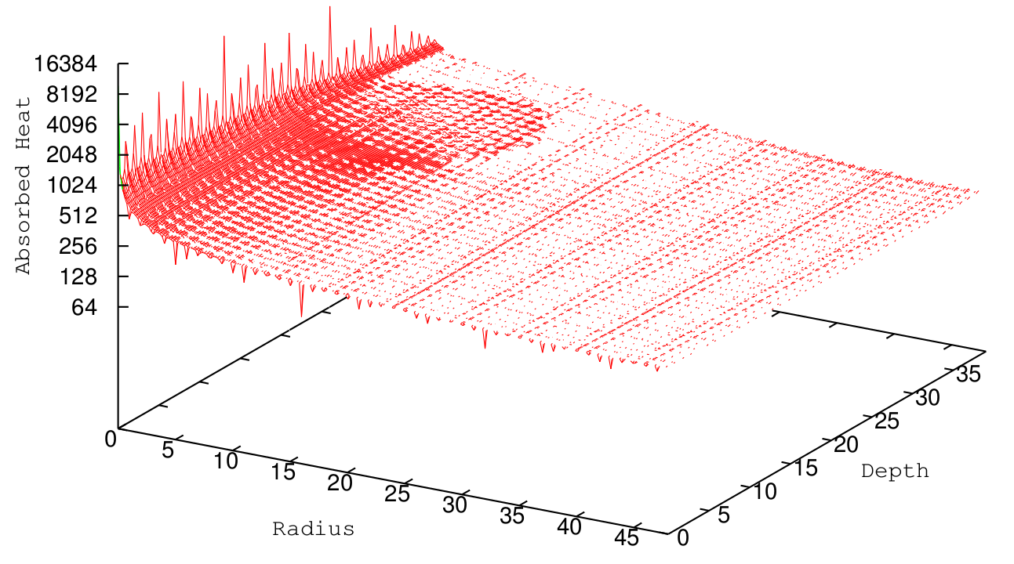
Simulation Output
Introduction | Design Overview | Experimental Results | Demo
15 / 21
Notes:
Sadegh

Slide 17
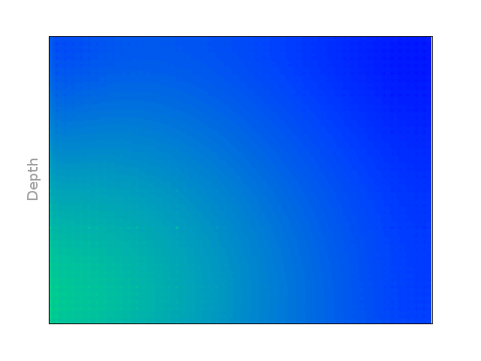
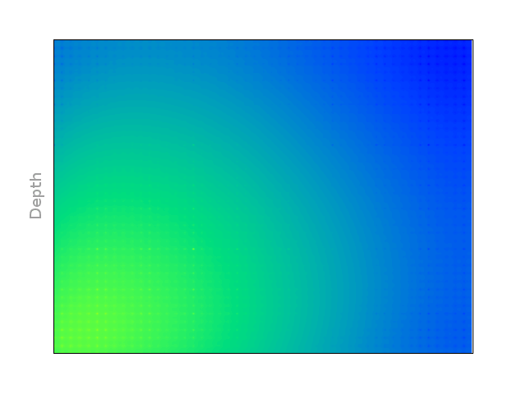
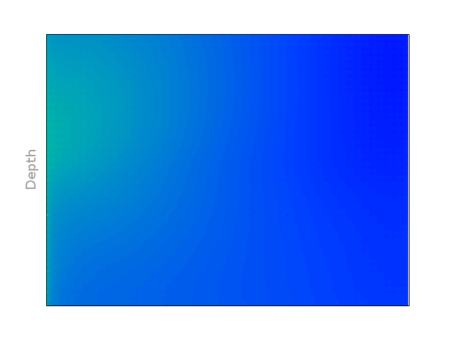
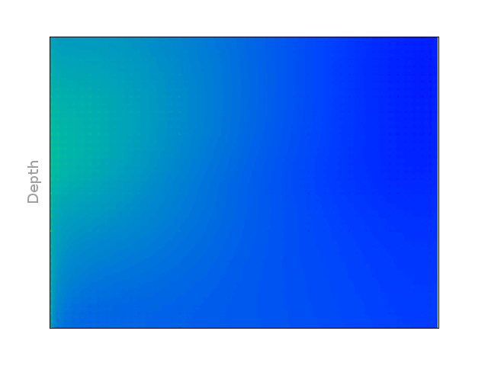
Simulation Output
Introduction | Design Overview | Experimental Results | Demo
16 / 21
Notes:
Sadegh

Slide 18
Speed-up
Introduction | Design Overview | Experimental Results | Demo
Features supported in base-line:
Absorption
Reflection
Transmission
Glass layer
Initiation Interval = 5
Speed-up for 1,000,000 photons:
Using 1 Hardware module: 34.5x
Utilizing 80% of the device: 103.5x
Note: dominant used element were slices (20.49% for 1 computation module)
17 / 21
Notes:
Jin hee

Slide 19
Speed-up vs Features
Introduction | Design Overview | Experimental Results | Demo
What if we remove/add features?
Frequency is kept at 100MHz for the sake of simplicity
More/less modules can be instantiated
Initiation interval may be reduced/increased
Would take ages without HLS!
18 / 21
Notes:
Jin hee

Slide 20
Speed-up vs Features
Introduction | Design Overview | Experimental Results | Demo
Glass Layer | + | + |  | + | +
Absorption | + | + | + |  | +
Transmission & Reflection | + | + | + | +
Partial Reflection | +
Max # for 80% utilization |  | 3 | 4 | 4 | 5 | 5
Initiation Interval |  | 5 | 5 | 5 | 5 | 3
Speed-up |  | 103.5x | 138x | 138x | 172.5x | 287.5x
19 / 21
Notes:
Jin hee

Slide 21
Impact of Number of Layers
Introduction | Design Overview | Experimental Results | Demo
Previous FPGA Implementations had severe limitations on Layer Count
Typically 5 layers
We store layer information in a Block RAM.
The results won’t change up to 125 layers for 32KB BRAM.
Afterwards, the BRAM size needs to be increased
20 / 21
Notes:
Lawrence

Slide 22
Demo
Introduction | Design Overview | Experimental Results | Demo
21 / 21
Notes:
Lawrence

Slide 23
Question & Answer
Introduction | Design Overview | Experimental Results | Demo
?

